Slide 1
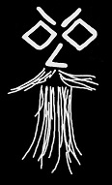
[+] Green is Good 558ms
[-] Red is Bad 168ms
Turning Your Checklists
into Pester Tests
Rob Sewell @sqldbawithbeard https://sqldbawithAbeard.com

Slide 2
TODAY’s TO DO LIST
GET UP
Drink Coffee
The Rest

Slide 3
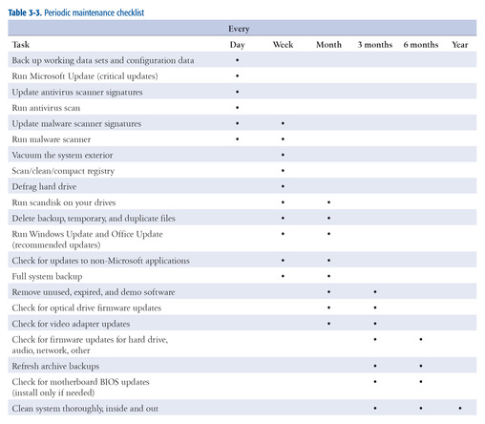
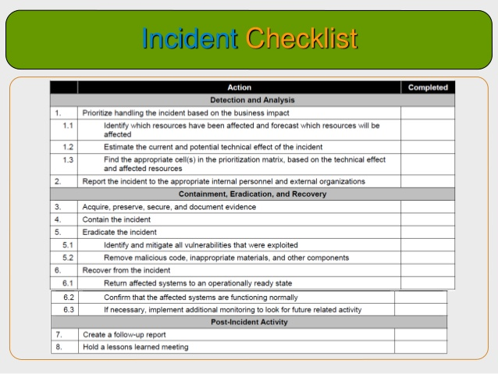
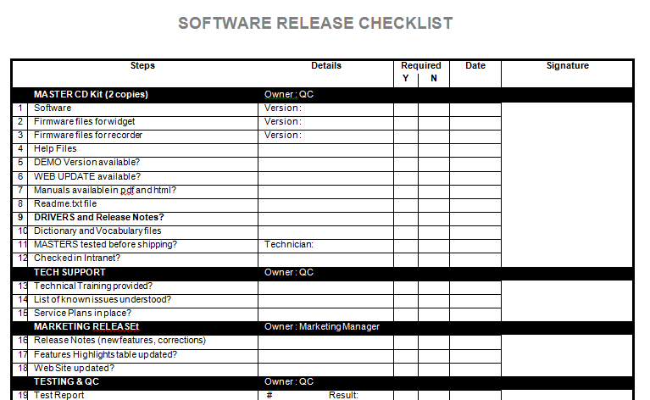
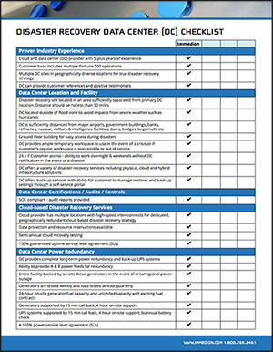
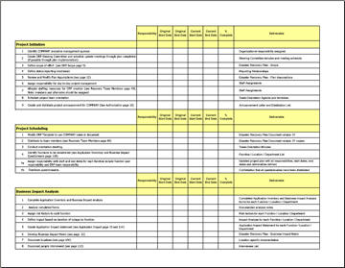
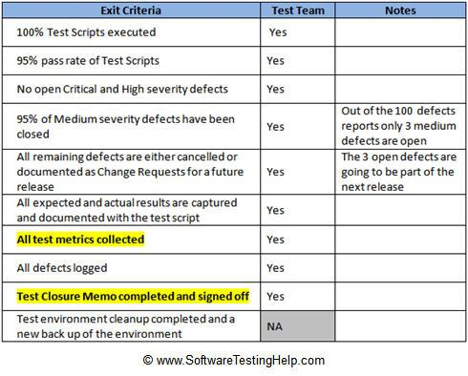
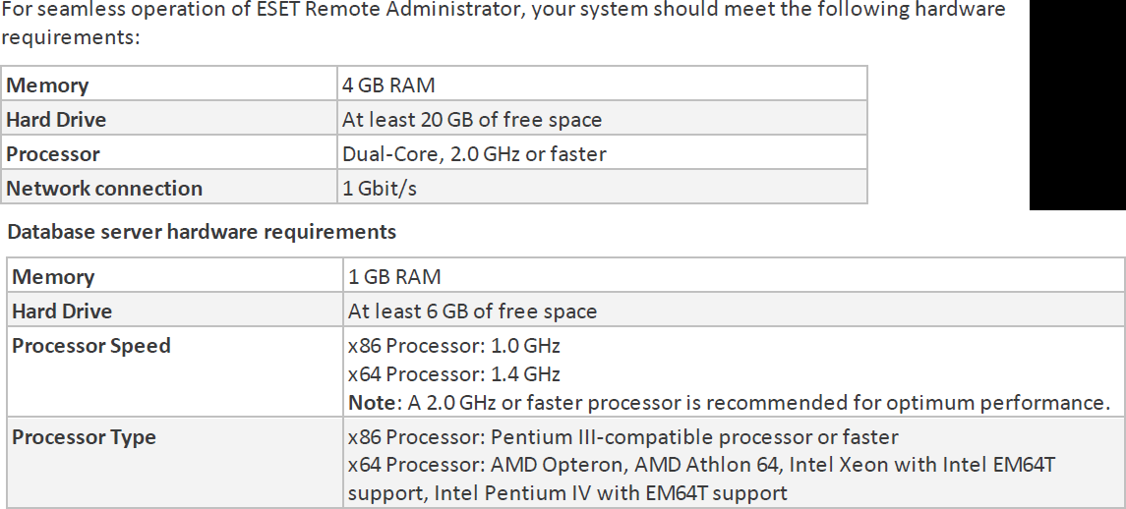
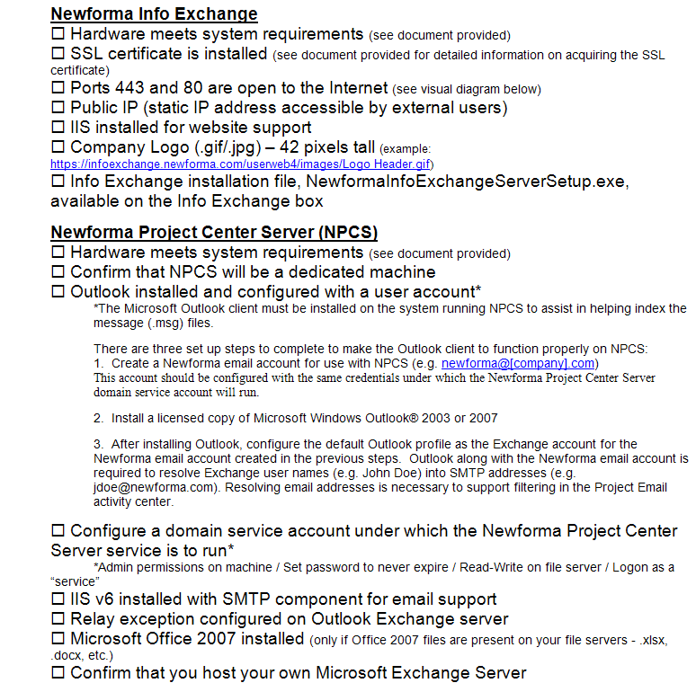
How Many Checklists Do You Have?
Notes:
I bet there are checklists for
New servers/ data centers
Hardware/software installations
Incident Response
1st Line/2nd line for systems
Pre-requisites
Morning routines

Slide 4
What about
Demos
Presentations
Morning Checks
Incident Response
First Line Support
I‘m sure you are already thinking of more

Slide 5
What is Pester?
Pester provides a framework for running unit tests to execute and validate PowerShell commands from within PowerShell
https://github.com/pester/Pester
Notes:
Its used for unit testing or TDD but can also be used to validate an environment. Comes with Windows 10 or install from the gallery with Install-Module Pester

Slide 6
What Does it Look Like?
Notes:
This is a Pester test running in VS Code

Slide 7
I’m Sorry!

Slide 8
Should Operators
Be Compares one object with another for equality. Case Insensitive BeExactly Compares one object with another for equality. Case Sensitive BeGreaterThan Asserts that a number is greater than an expected value. BeLessThan Asserts that a number is less than an expected value. BeLike Asserts that the actual value matches a wildcard pattern using -like operator. Case Insensitive BeLikeExactly Asserts that the actual value matches a wildcard pattern using -like operator. Case Sensitive BeOfType Asserts that the actual value should be an object of a specified type Exist Does not perform any comparison but checks if the object calling Exist is present in a PS Provider. Contain Checks to see if a file contains the specified text. Case Insensitive ContainExactly Checks to see if a file contains the specified text. Case Sensitive Match Uses a regular expression to compare two objects. Case Insensitive MatchExactly Uses a regular expression to compare two objects. Case Sensitive Throw Checks if an exception was thrown in the input ScriptBlock. BeNullOrEmpty Checks values for null or empty (strings).
I Hate slides with lots of text but I think this one is valid

Slide 9

So What Can You Validate?
Notes:
Everything in the world ☺

Slide 10
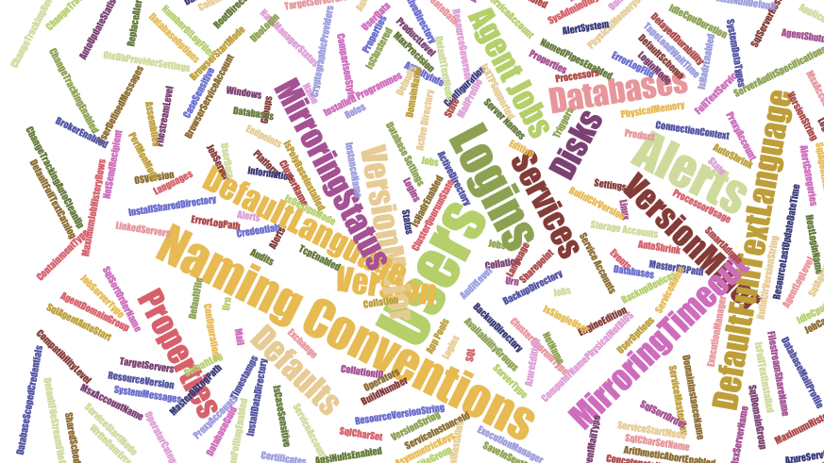
Maybe not EVERY thing but anything you can check with PowerShell

Slide 11

Hey Beardy!
Time For A DEMO

Slide 12
Summary
We all have checklists – manual testing is error-prone
Pester is a Unit Testing Framework for PowerShell
You can use it to validate your infrastructure
The basic syntax - Describe, Context and It code blocks
The Should command is used for testing assertions
Use the NunitXML output and the reportviewer.exe to make HTML reports
Rob Sewell @sqldbawithbeard https://sqldbawithAbeard.com

Slide 13
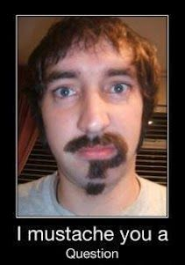
Questions?
?
?
?
?
?
?
?
?
?
?
?
?
?
?
?
?
Rob Sewell @sqldbawithbeard https://sqldbawithAbeard.com

